Slide 1
Molecular Modeling based Virtual Screening
BIOINF595 Winter 2025
Matthew O’Meara

Slide 2
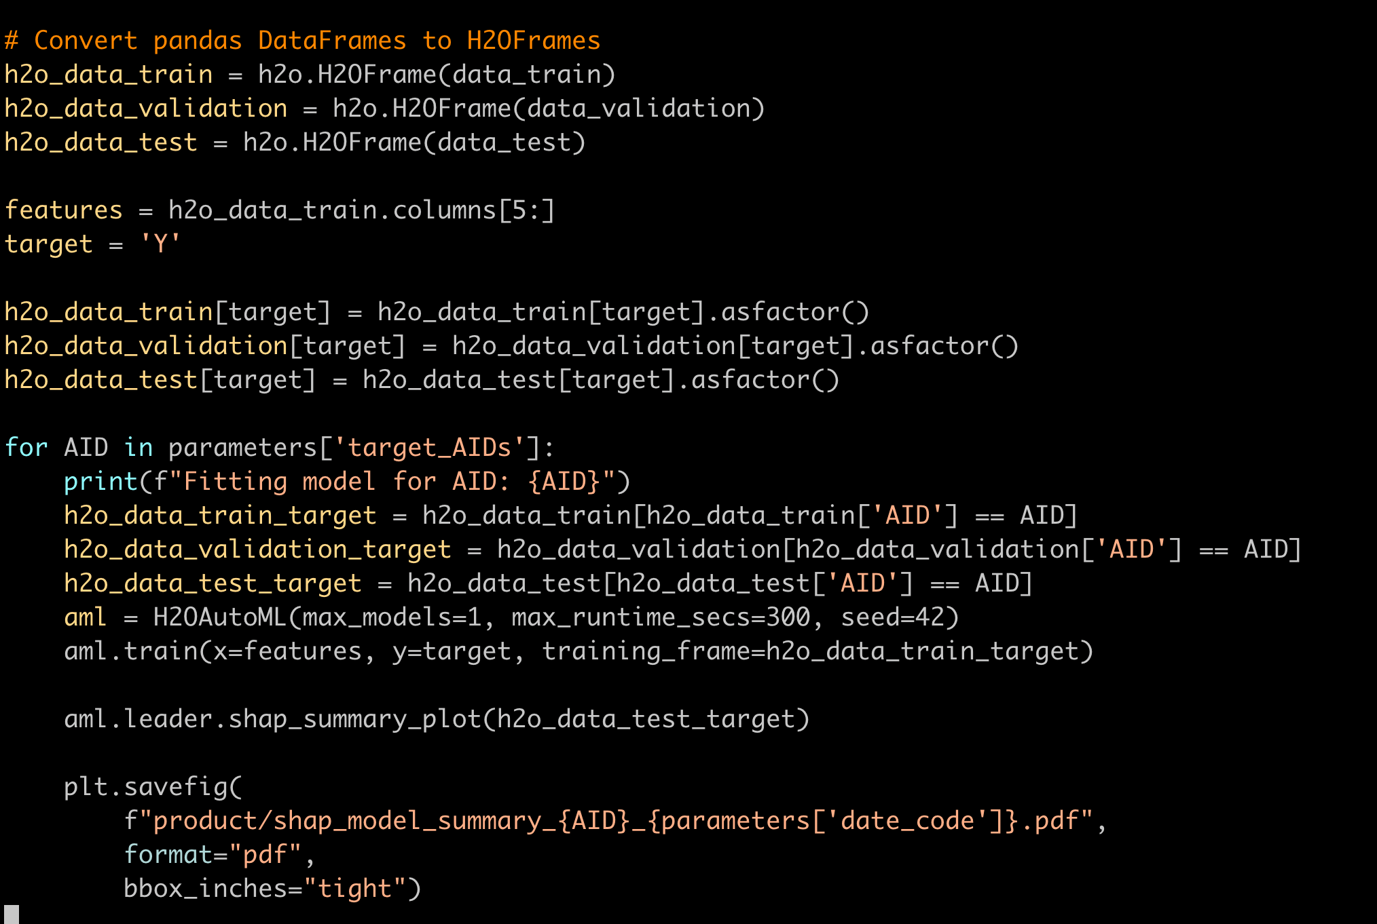
Admin details
Lab 5

Slide 3
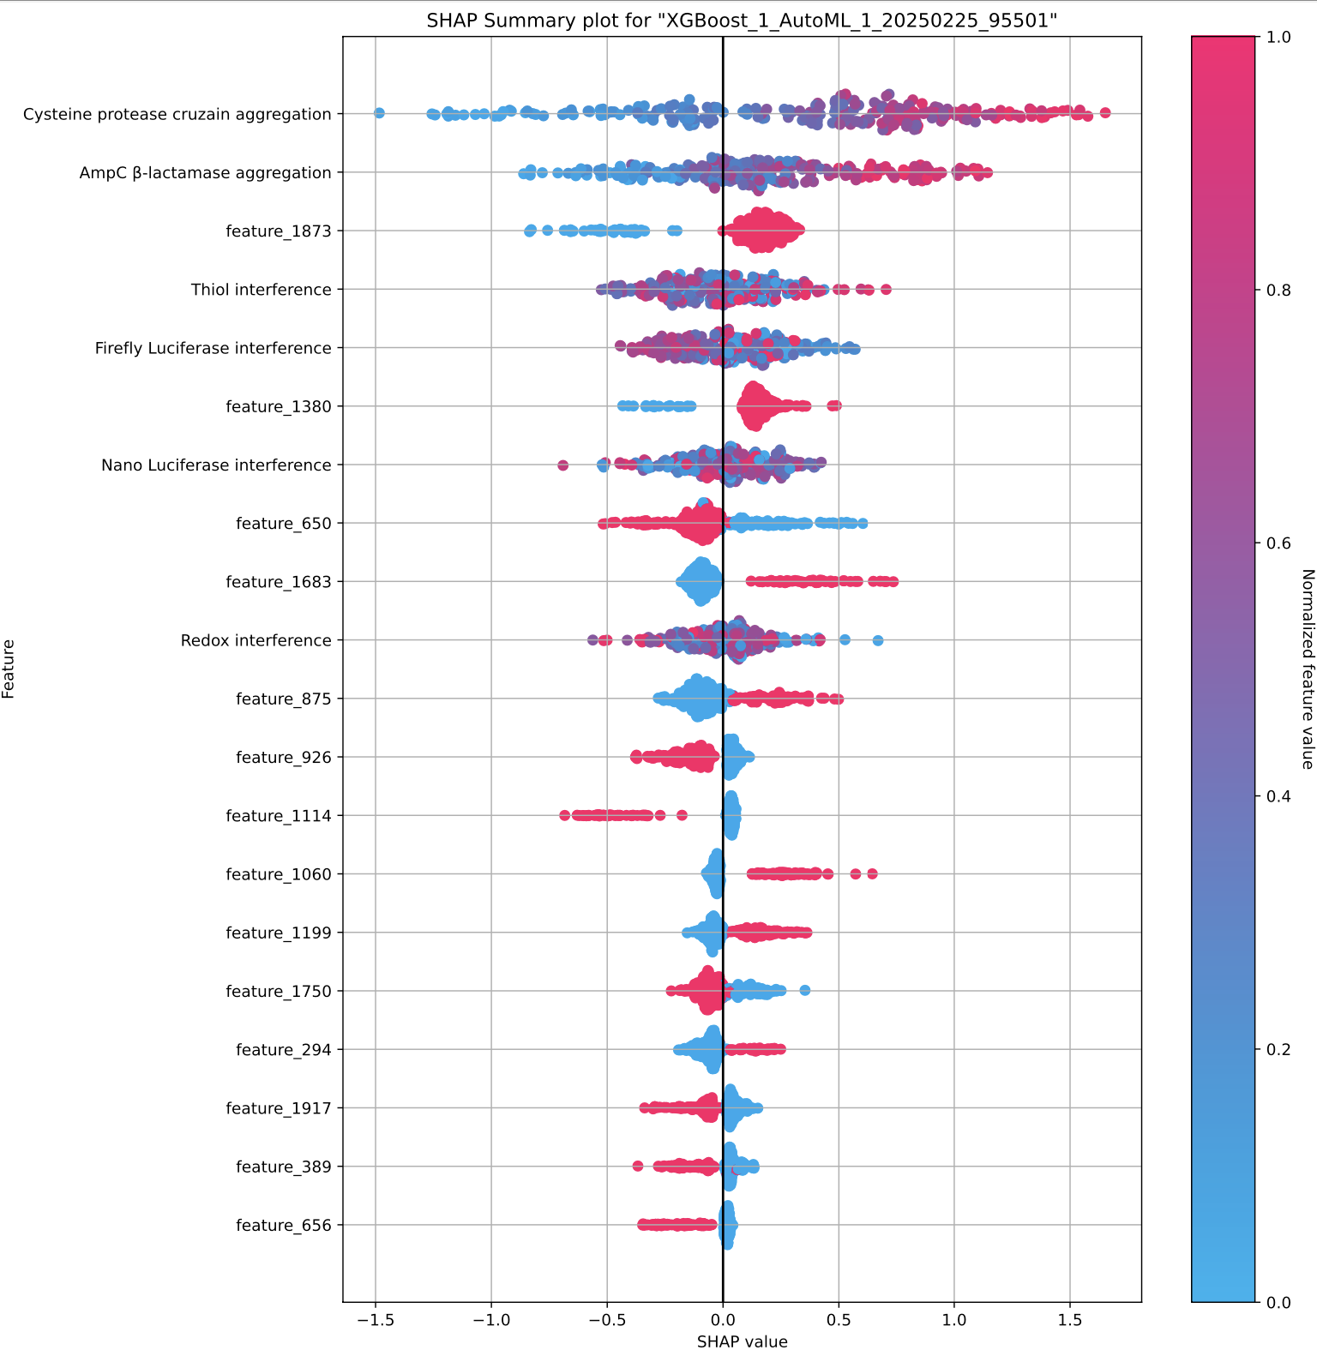
Lab 5 SHAP Plot

Slide 4
Effort, grades, final project
Goal of the course is to learn
Different people are coming in with different background
If you get stuck, ask for help, work together, come to office hours
Assignment grades evaluate based on rubric of success + effort
Overall grades will be curved to reflect overall effort (please don’t worry!)
Please come talk to me if you are concerned
Final projects
Concrete details for both Terra and Matt’s projects on Friday
Are taking into account how the labs have gone so far to make the final projects tractable.

Slide 5
Inputs
Computation
Predictions
Quantum
Theory
Sampling
Protocol
Characterized
Structures
Structure
Prediction
Structure
Representation
Function
Design
Experimental
Measurements
Energy Function
Energy
Traptavidin: 2Y32
Deviation from Native (RMSD)

Slide 6
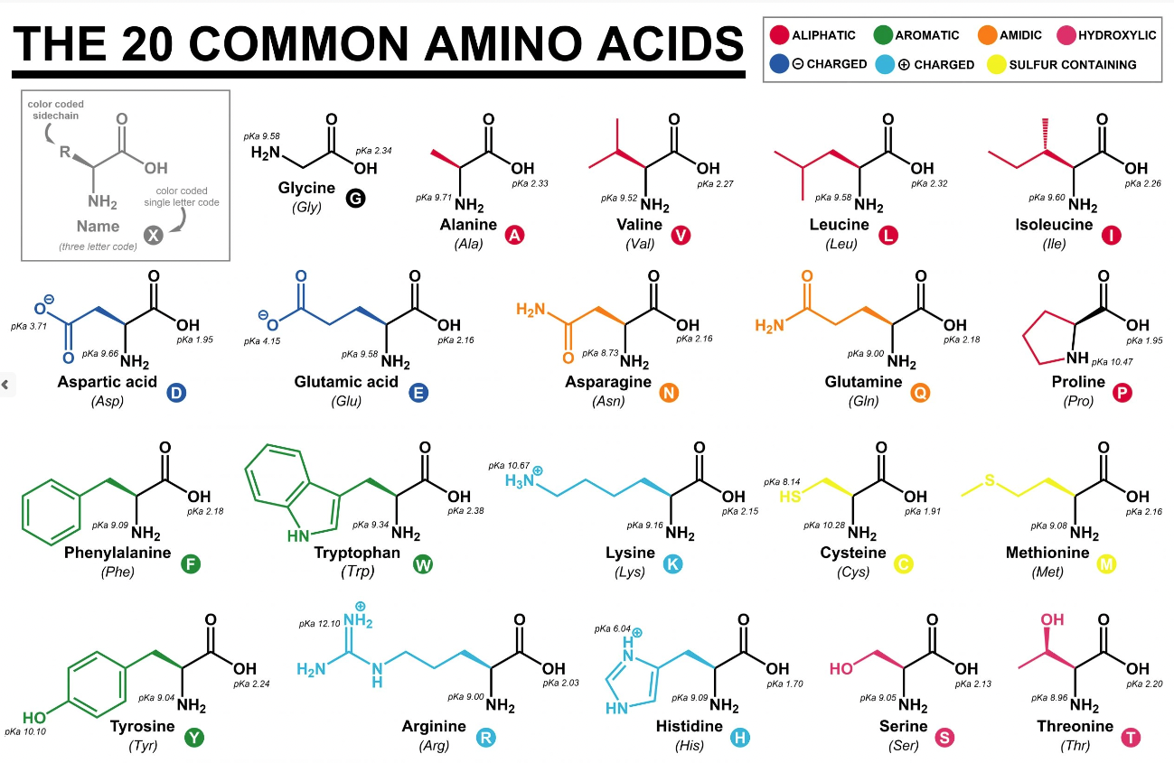
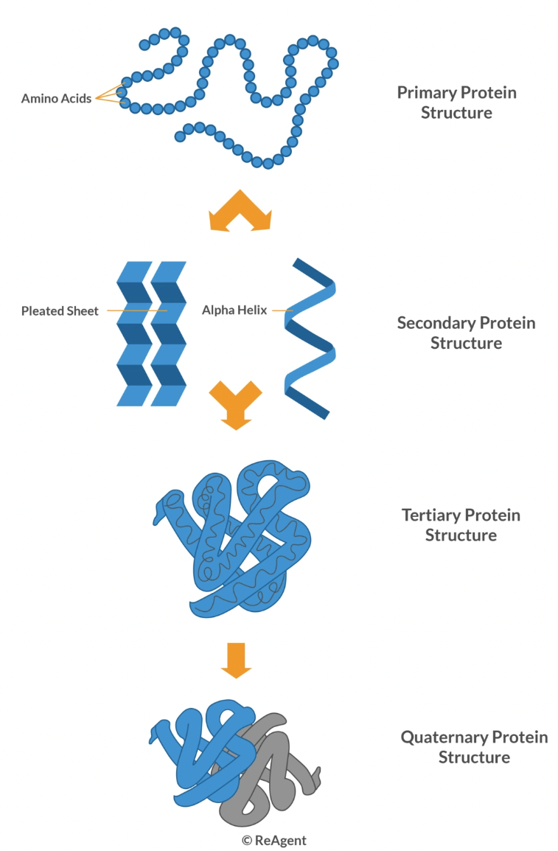
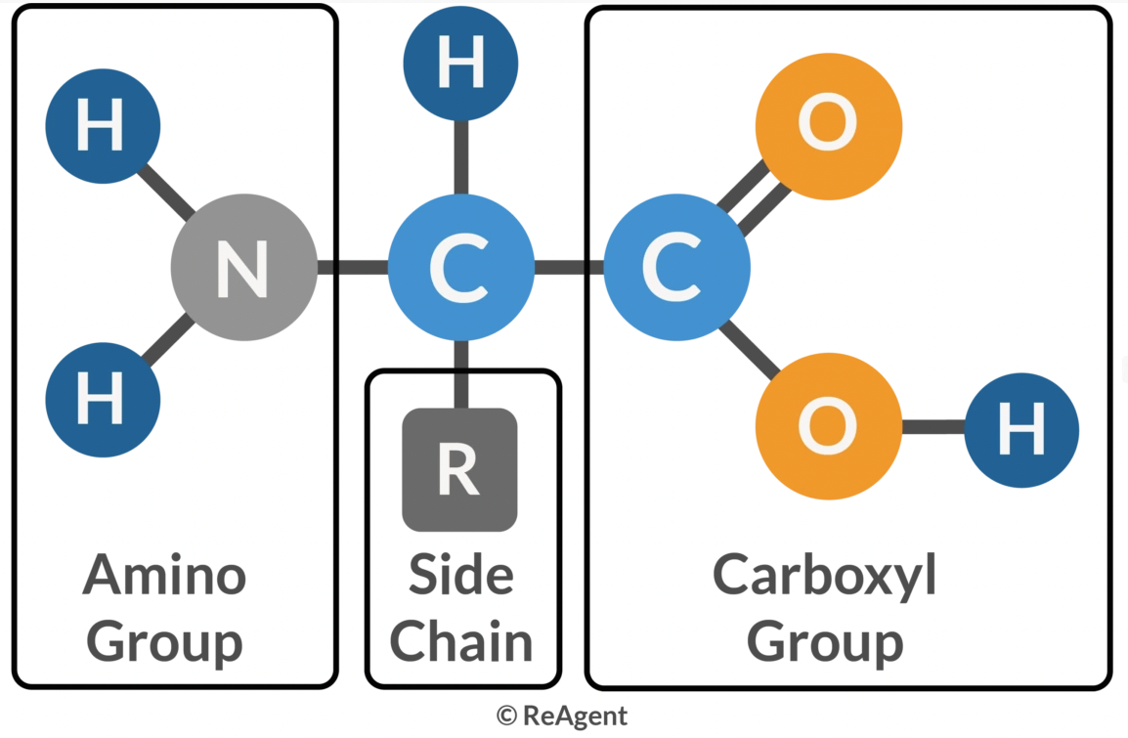
Amino acids => Protein structure
https://www.reagent.co.uk/what-are-amino-acids/

Slide 7
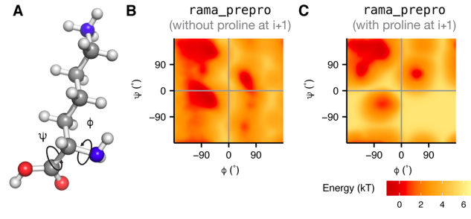
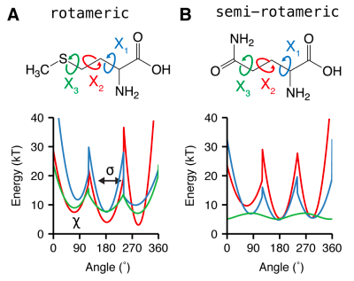
Backbone and sidechain torsion angle models

Slide 8
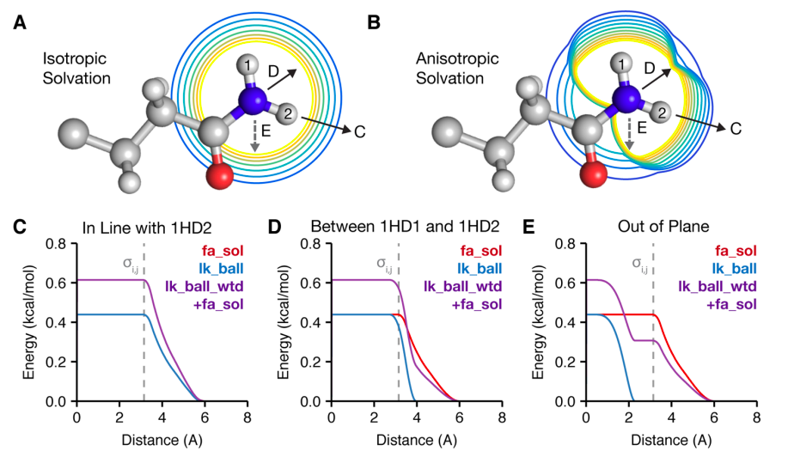
Lazaridis−Karplus solvation model

Slide 9
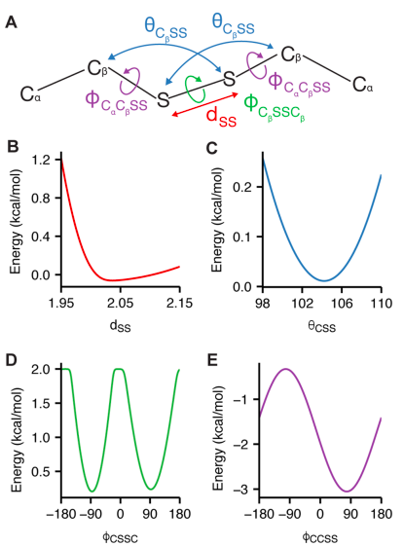
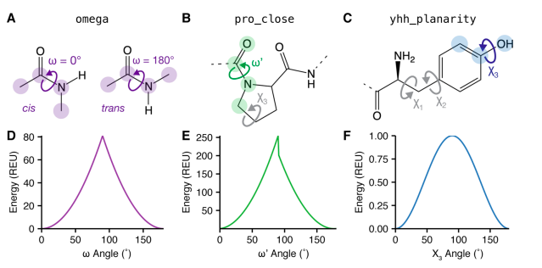
Special cases energy terms

Slide 10
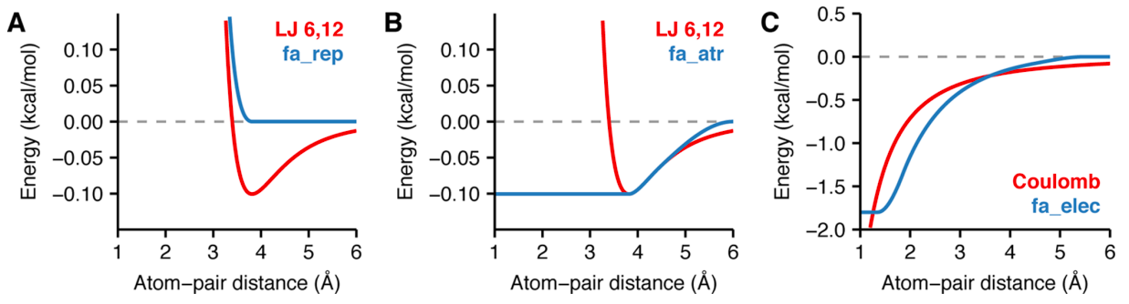
Lennard-Jones van der Walls and electrostatics model

Slide 11
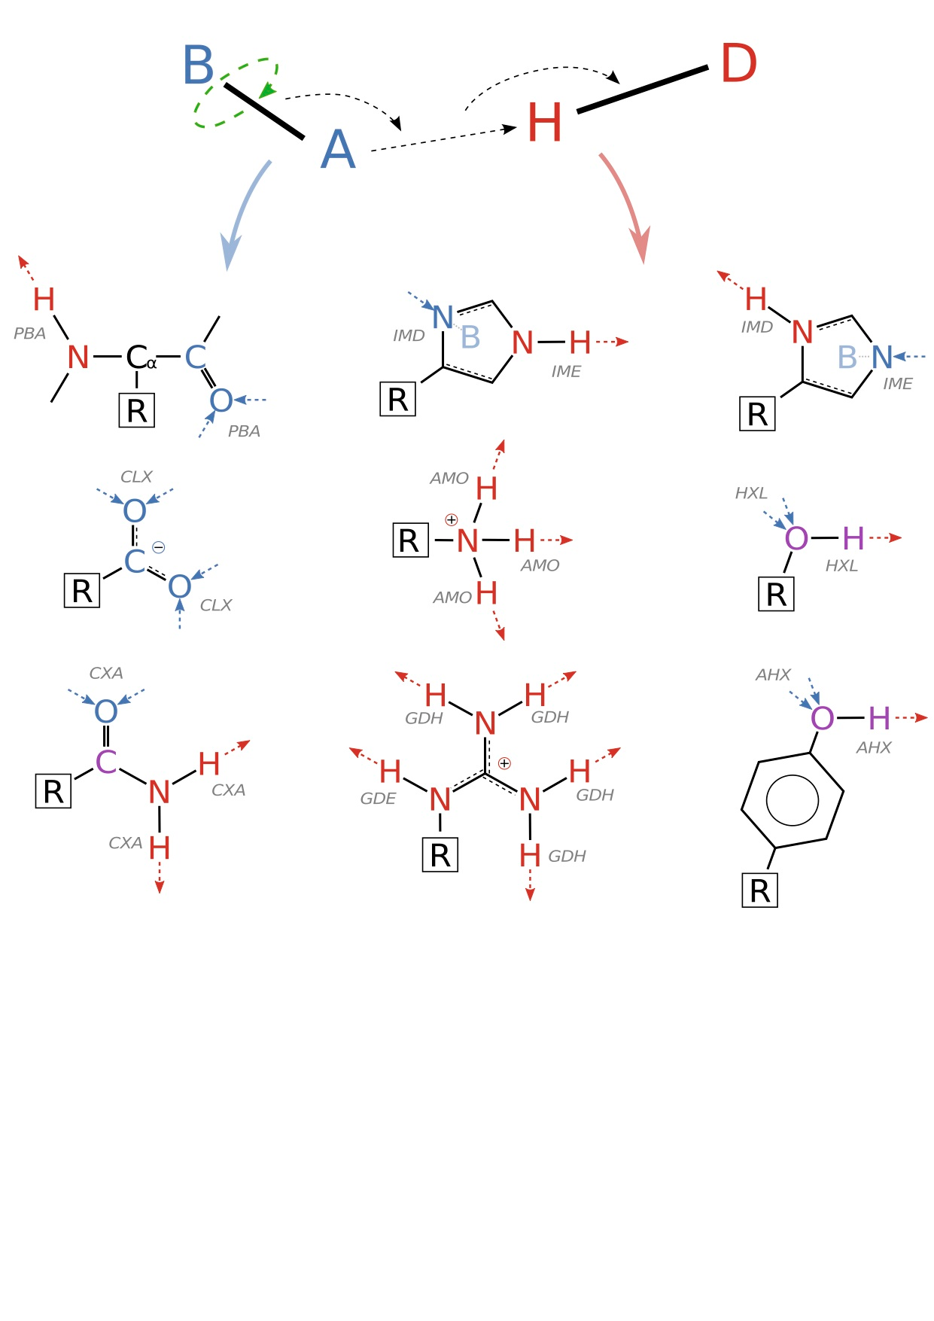
Focus on specific structural features e.g. H-bonds

Slide 12
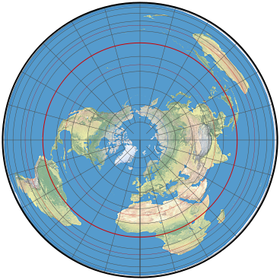
Equal Area Projections

Slide 13
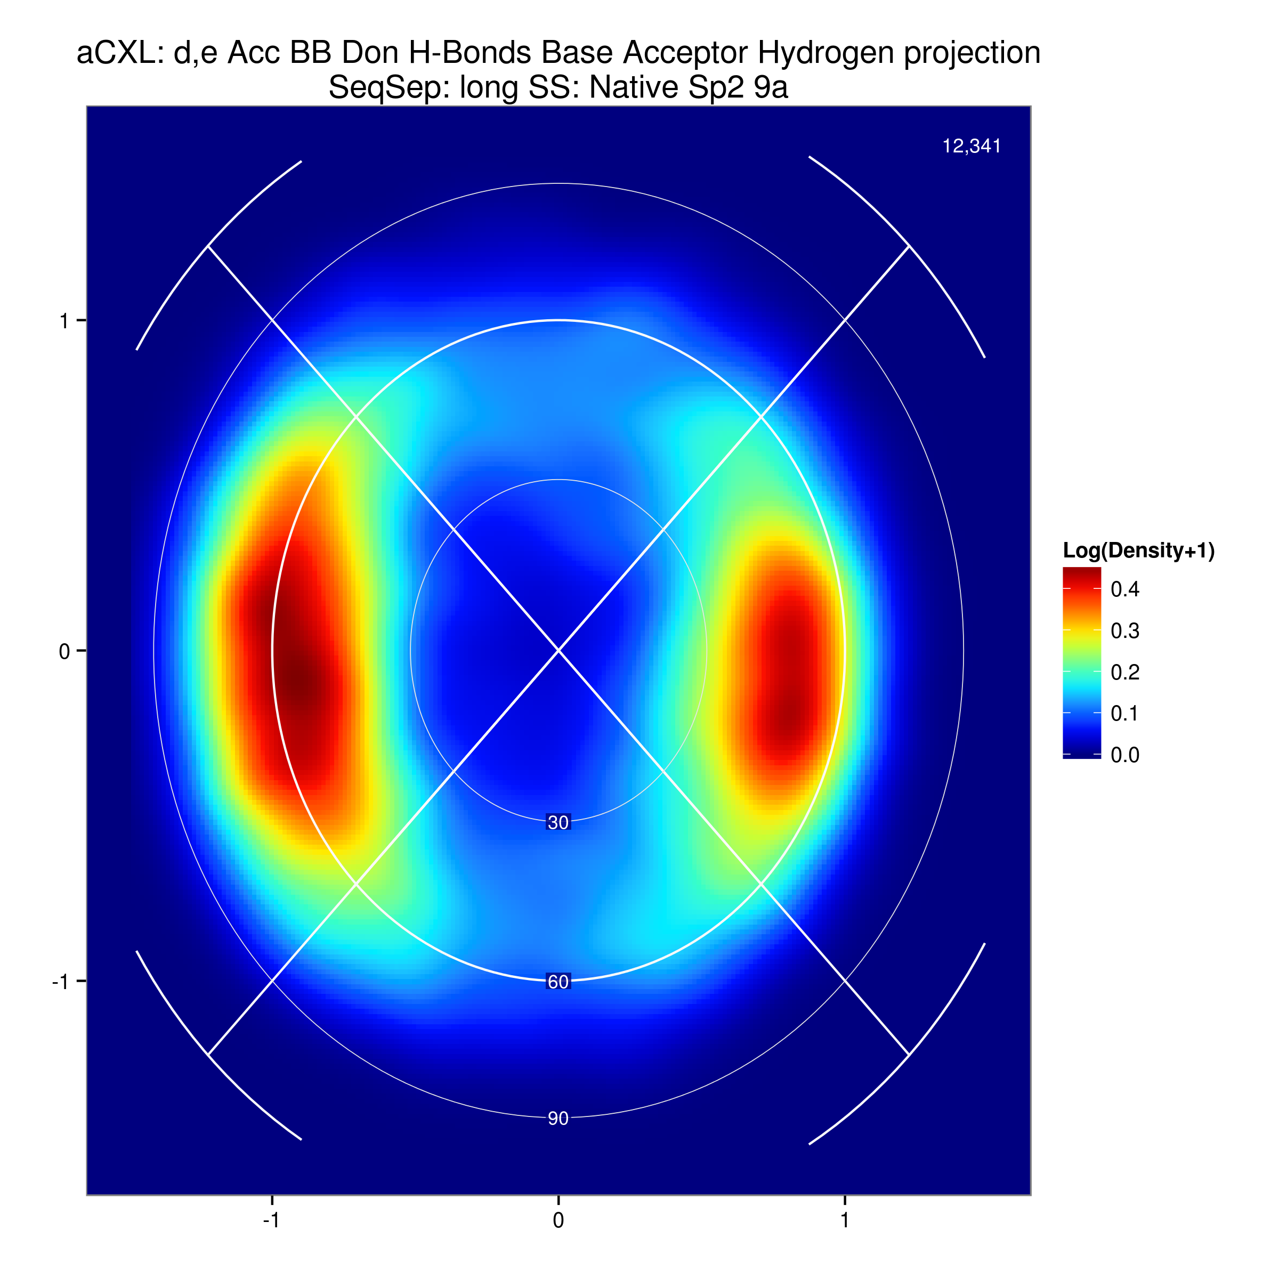
ASP/GLU -> Backbone

Slide 14
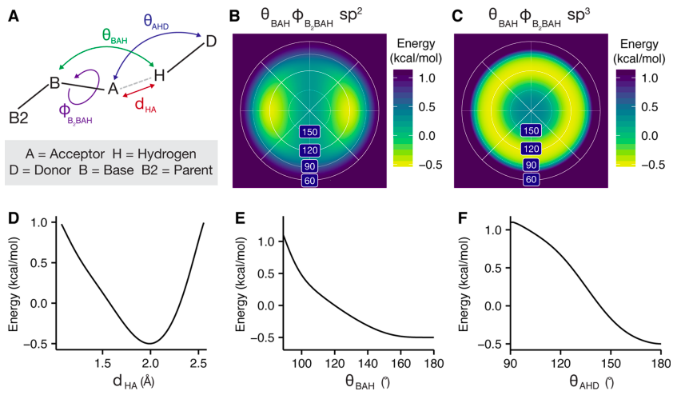
H-bond model

Slide 15
Leaver-Fay et al. 2013

Slide 16
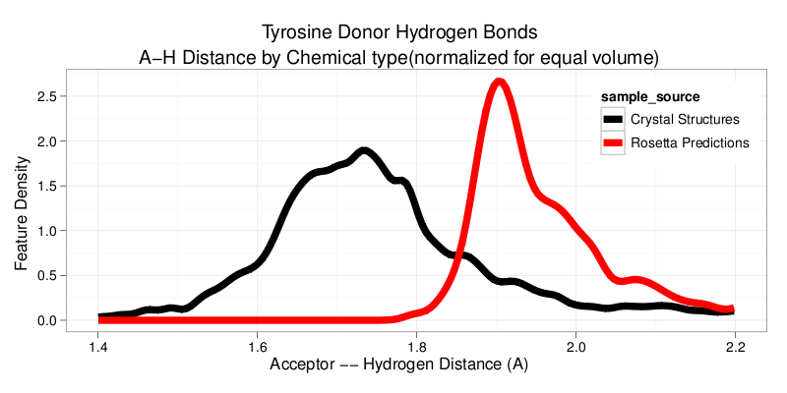
Simulation based inference to improve energy functions
If any two feature distributions differ then the full distributions are not identical

Slide 17
Serine, Threonine Donating to Backbone Amine Nitrogen
Leaver-Fay et al. 2013

Slide 18
ASP/GLU -> Backbone

Slide 19
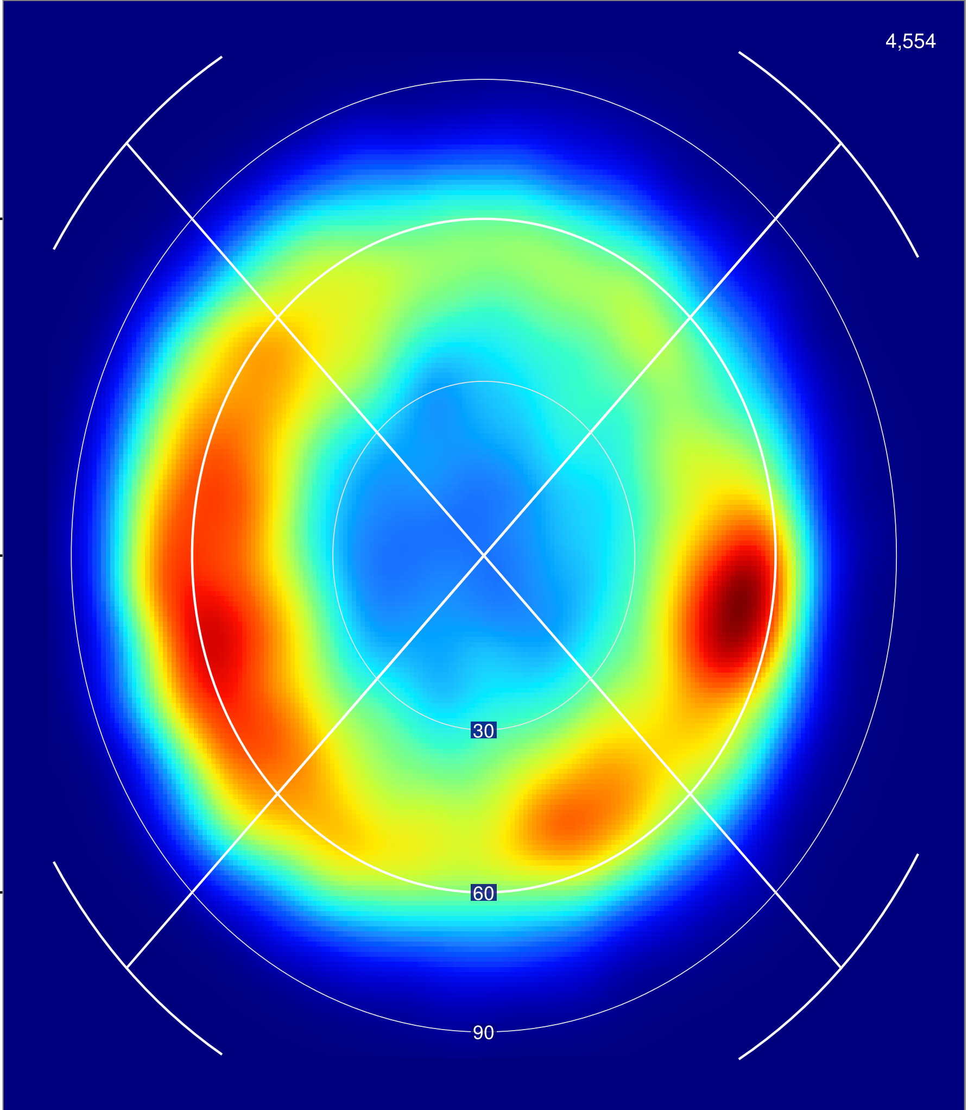
ASP/GLU -> Backbone
Native
Rosetta

Slide 20
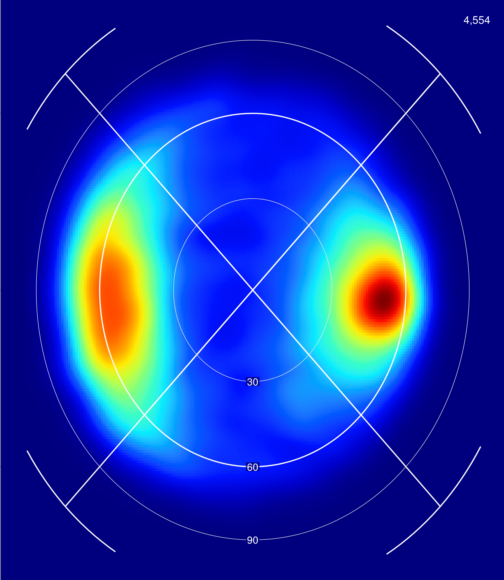
ASP/GLU -> Backbone
Native
Rosetta (New H-Bond)

Slide 21
Backbone -> Backbone: β-Sheet
Native
Rosetta
Rosetta (New H-Bond)

Slide 22
O’Meara et al., 2014

Slide 23
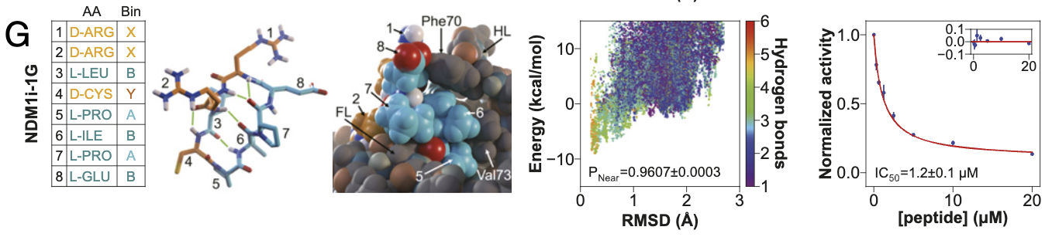
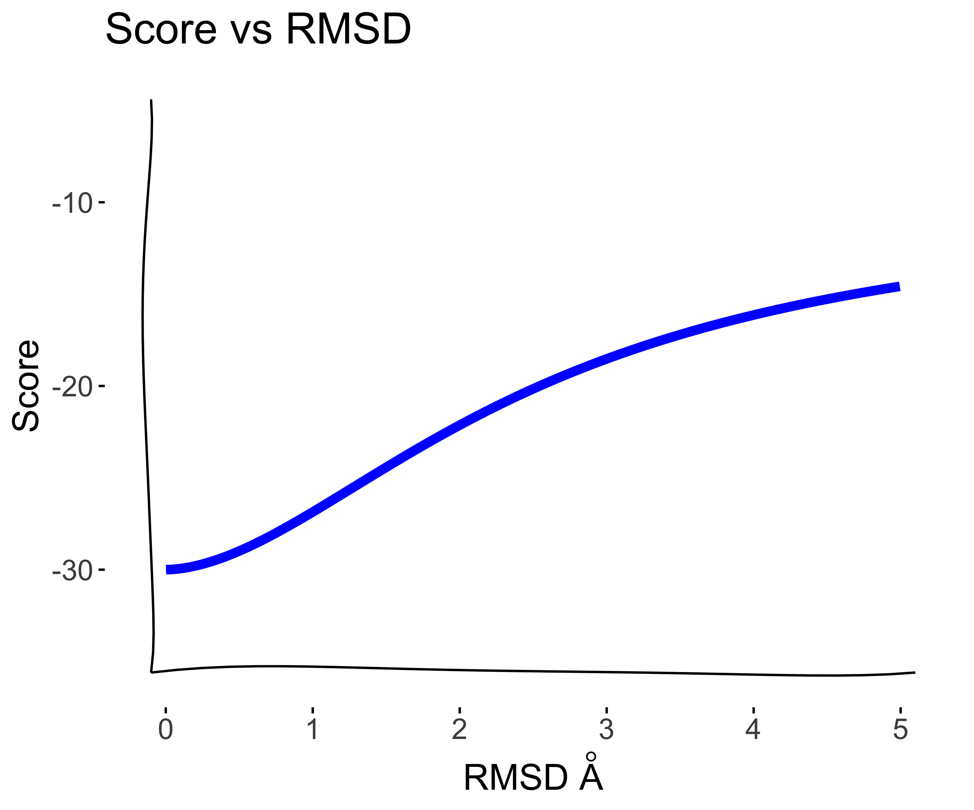
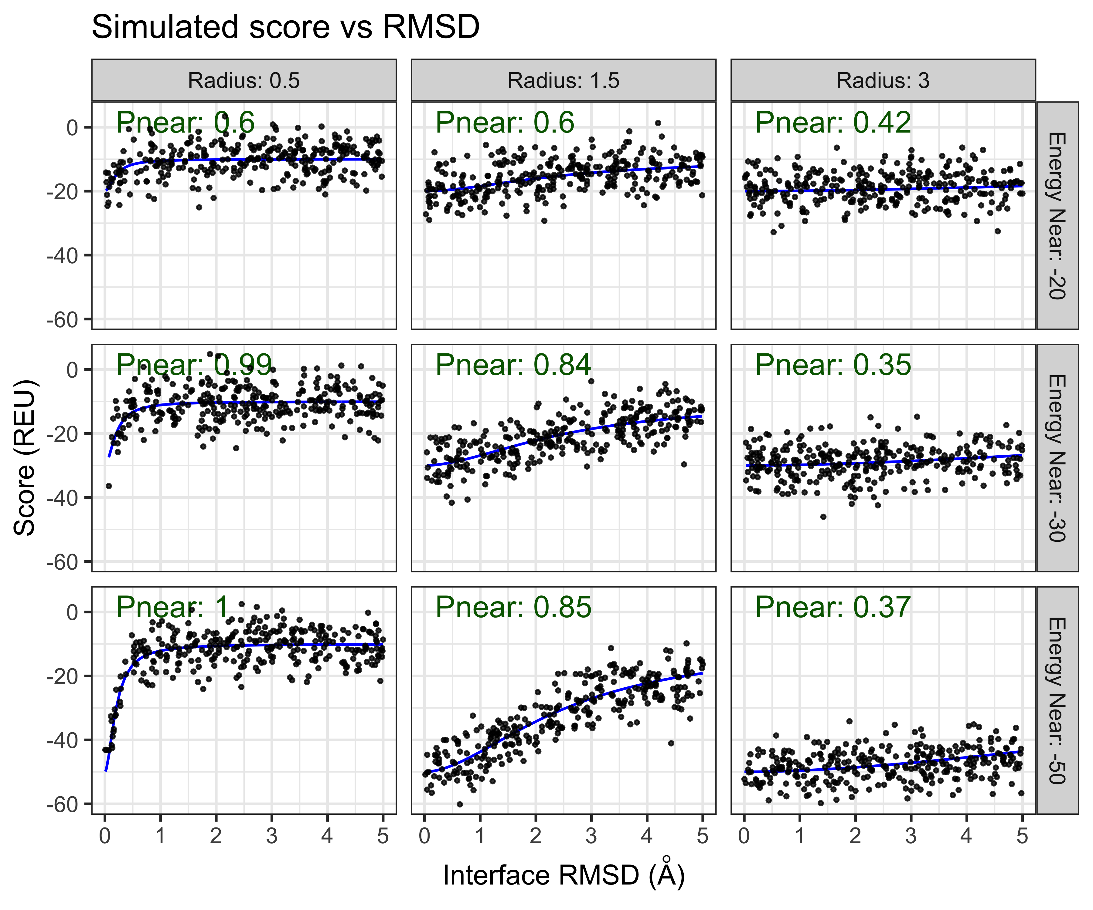
Pnear: Measure the “Funnelness” of score vs. rmsd

Slide 24
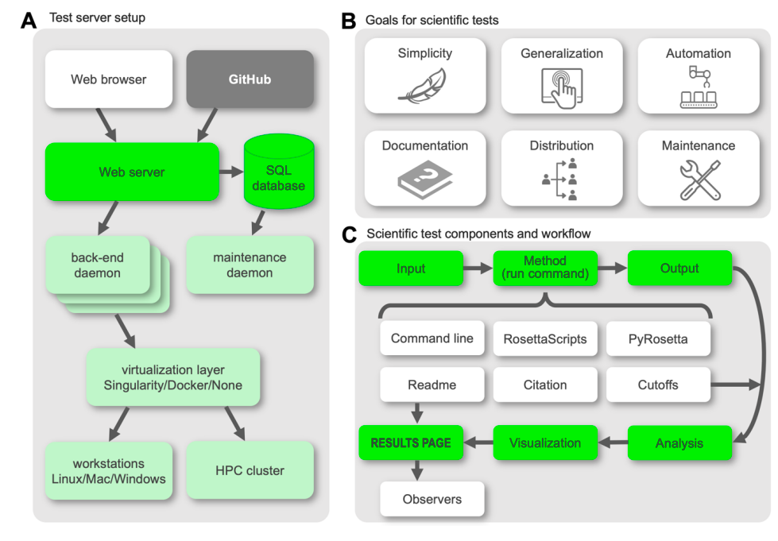
Rosetta Scientific Benchmark Server
(Koehler Leman et al., 2021)

Slide 25
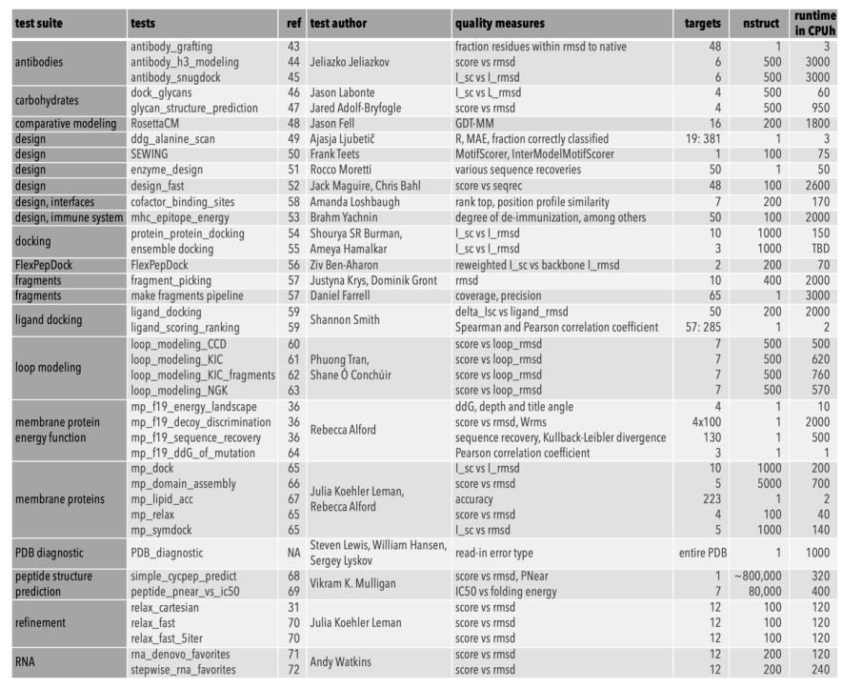
Rosetta Scientific Benchmarks
(Koehler Leman et al., 2021)

Slide 26
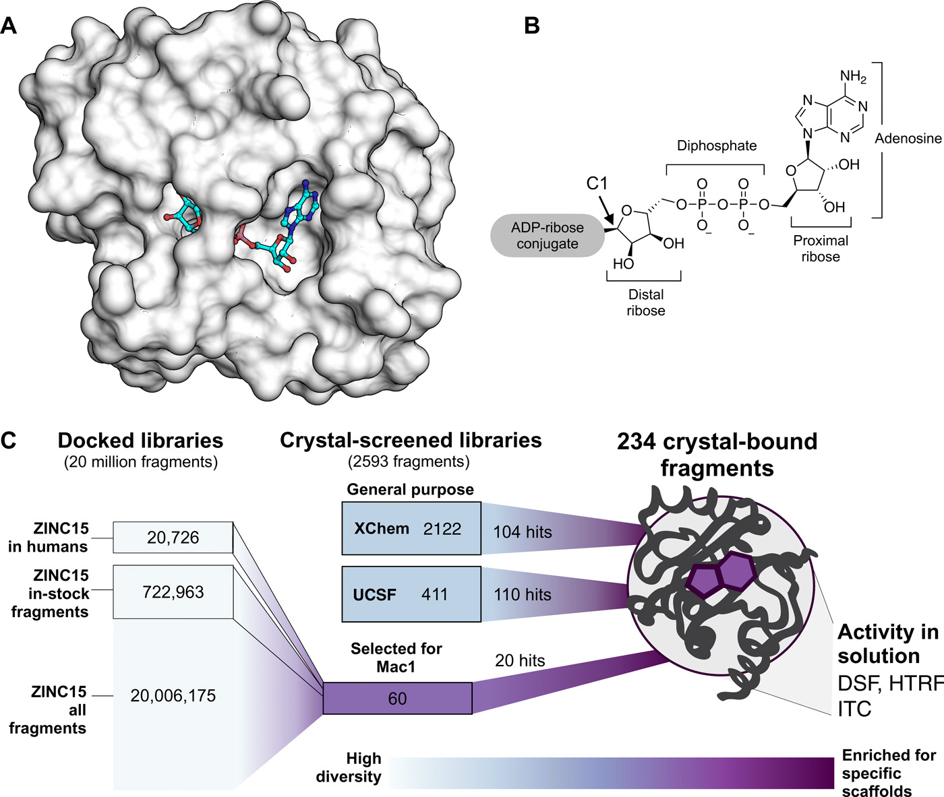
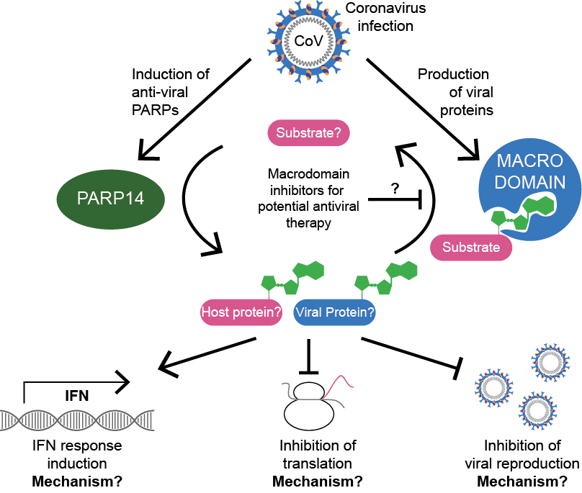
Nsp3 Macrodomain

Slide 27
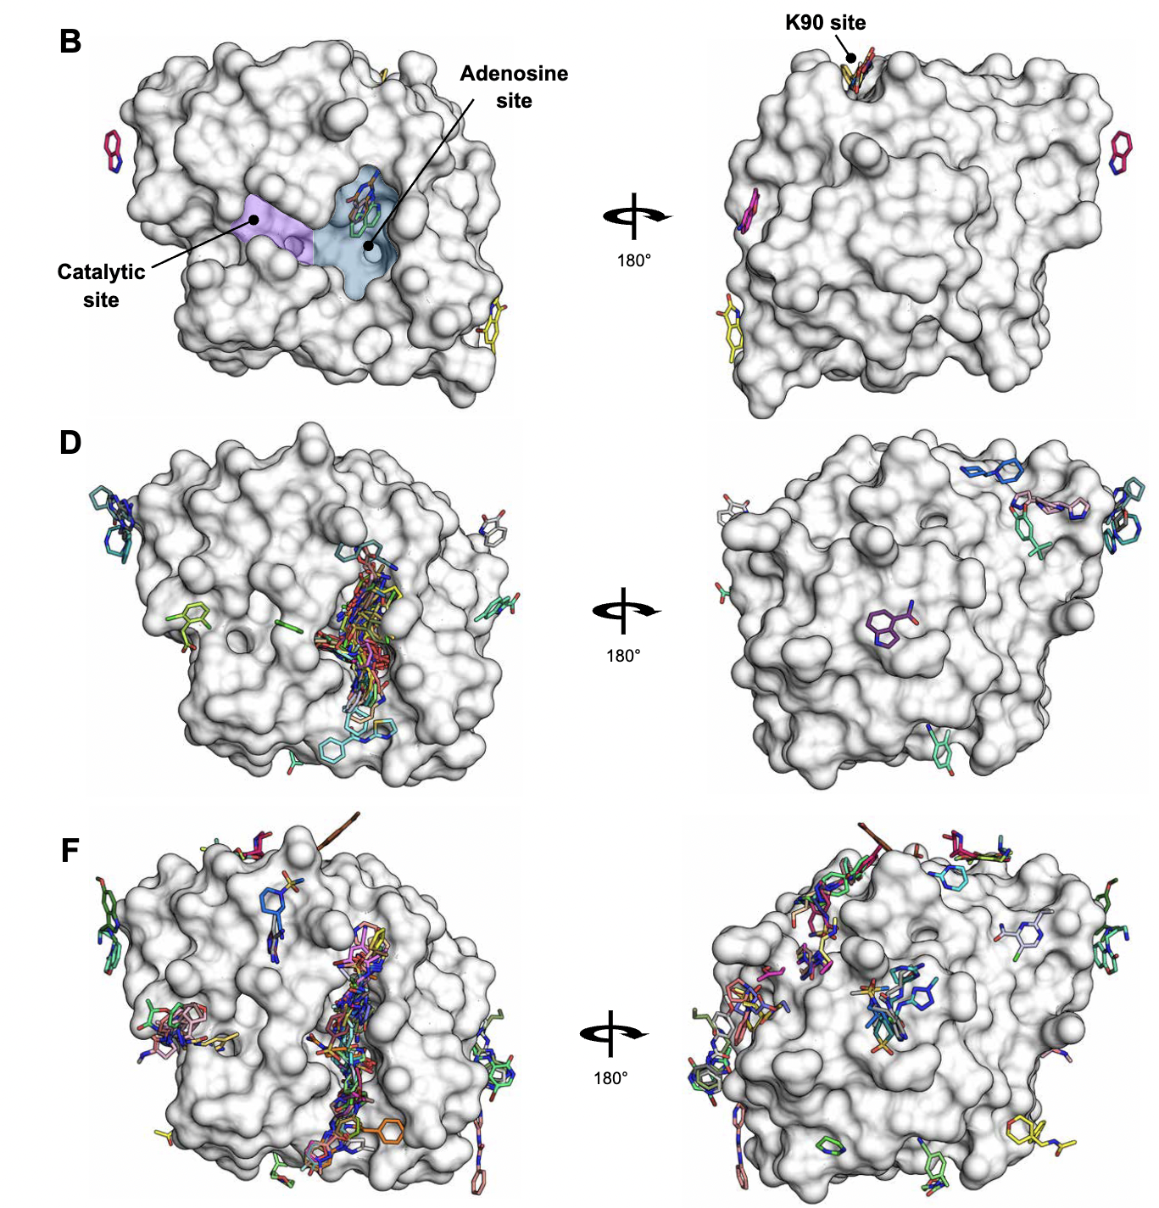
X-tal Fragment screen against the Nsp3 macrodomain
Soak
2533 diverse fragments
resulted in
214 unique macrodomain-bound
structures
(Schuller, et al., 2021)
Notes:
Fragment binding to the Nsp3 macrodomain of SARS-CoV-2 identified through crystallographic screening and computational dockingMarion Schuller, Galen J. Correy, Stefan Gahbauer, Daren Fearon, Taiasean Wu, Roberto Efraín Díaz, Iris D. Young, Luan Carvalho Martins, Dominique H. Smith, Ursula Schulze-Gahmen, Tristan W. Owens, Ishan Deshpande, Gregory E. Merz, Aye C. Thwin, Justin T. Biel, Jessica K. Peters, Michelle Moritz, Nadia Herrera, Huong T. Kratochvil, QCRG Structural Biology Consortium, Anthony Aimon, James M. Bennett, Jose Brandao Neto, Aina E. Cohen, Alexandre Dias, Alice Douangamath, Louise Dunnett, Oleg Fedorov, Matteo P. Ferla, Martin R. Fuchs, Tyler J. Gorrie-Stone, James M. Holton, Michael G. Johnson, Tobias Krojer, George Meigs, Ailsa J. Powell, Johannes Gregor Matthias Rack, Victor L. Rangel, Silvia Russi, Rachael E. Skyner, Clyde A. Smith, Alexei S. Soares, Jennifer L. Wierman, Kang Zhu, Peter O’Brien, Natalia Jura, Alan Ashworth, John J. Irwin, Michael C. Thompson, Jason E. Gestwicki, Frank von Delft, Brian K. Shoichet, James S. Fraser and Ivan Ahel
SCIENCE ADVANCES
14 Apr 2021, Vol 7, Issue 16 DOI: 10.1126/sciadv.abf8711

Slide 28
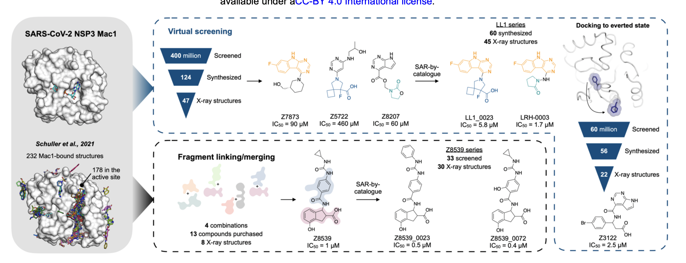
Virtual screening campaign against Nsp3 Macrodomain
facilitated identifying diverse binders that were optimized through medicinal chemistry
(Gahbauer, 2022)

Slide 29
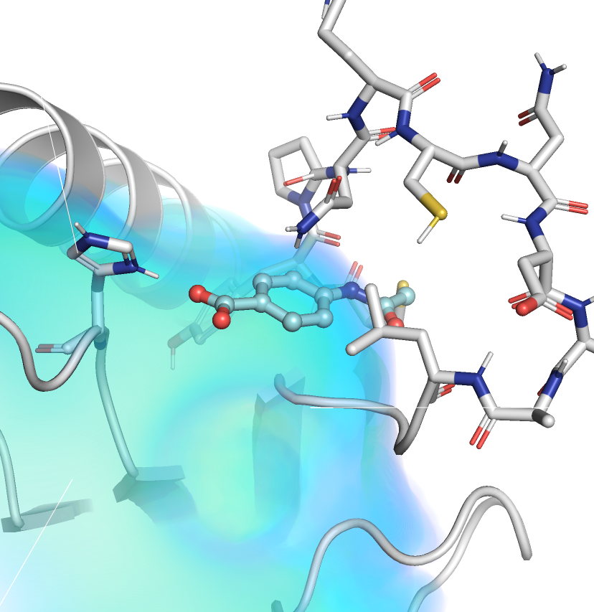
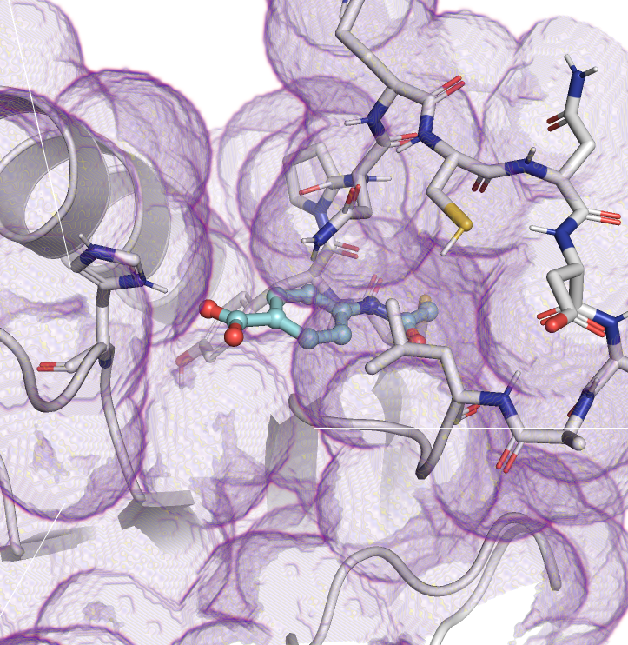
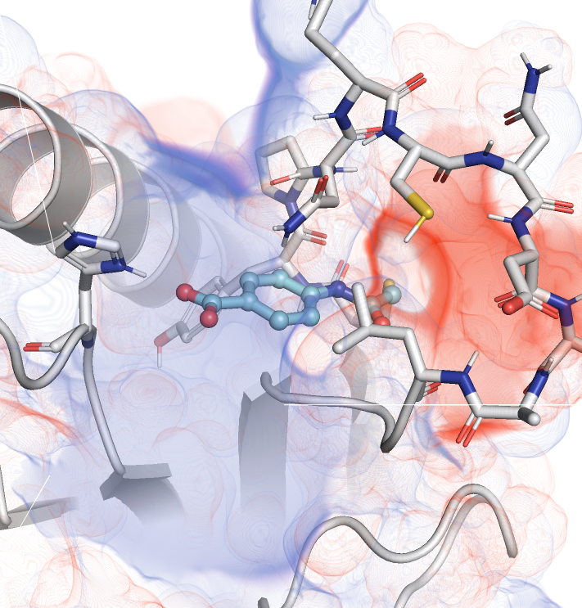
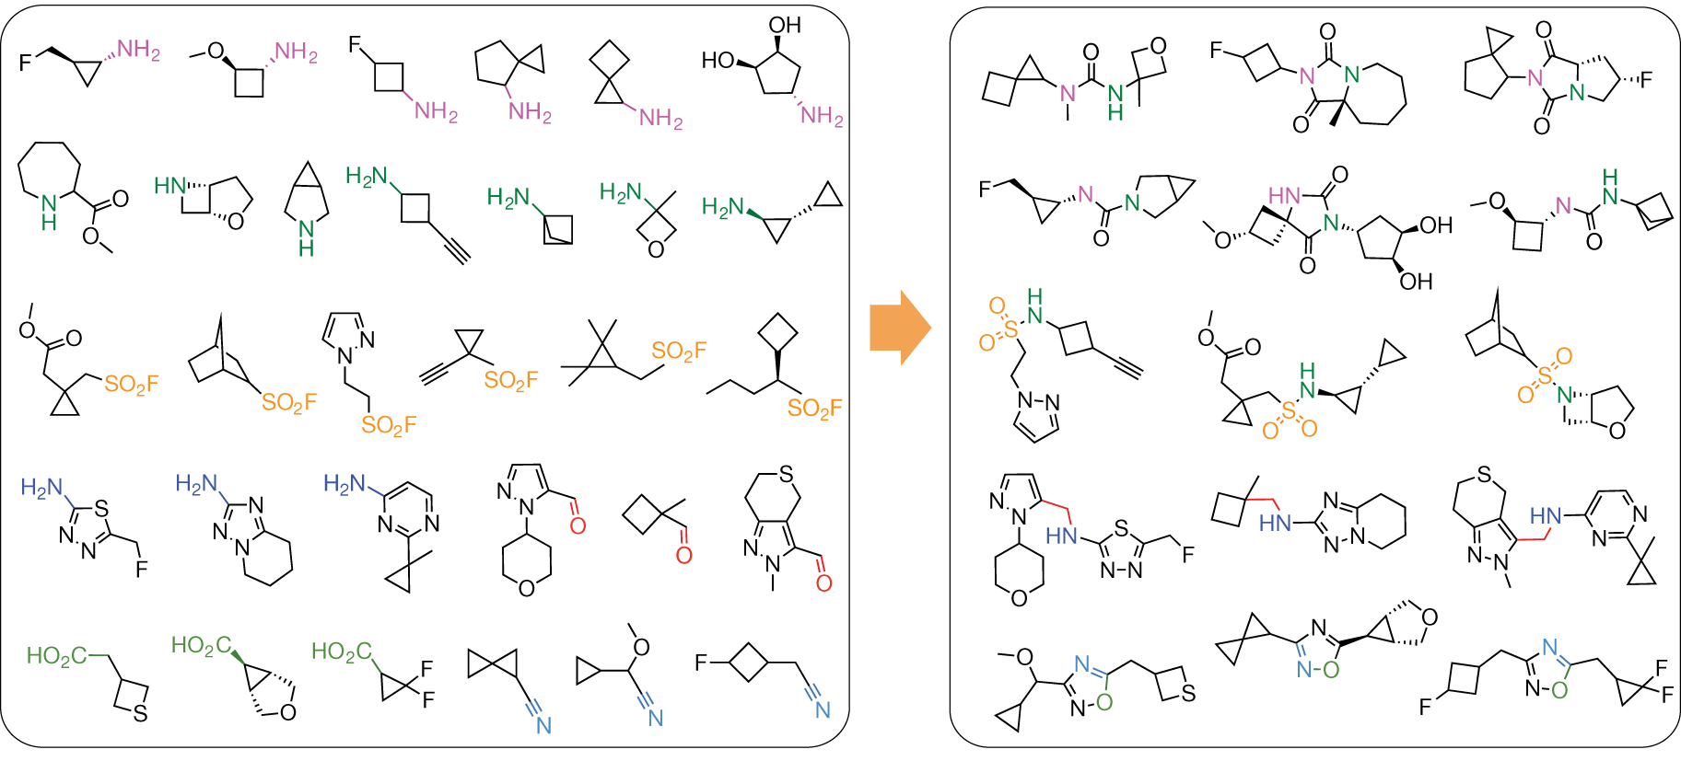
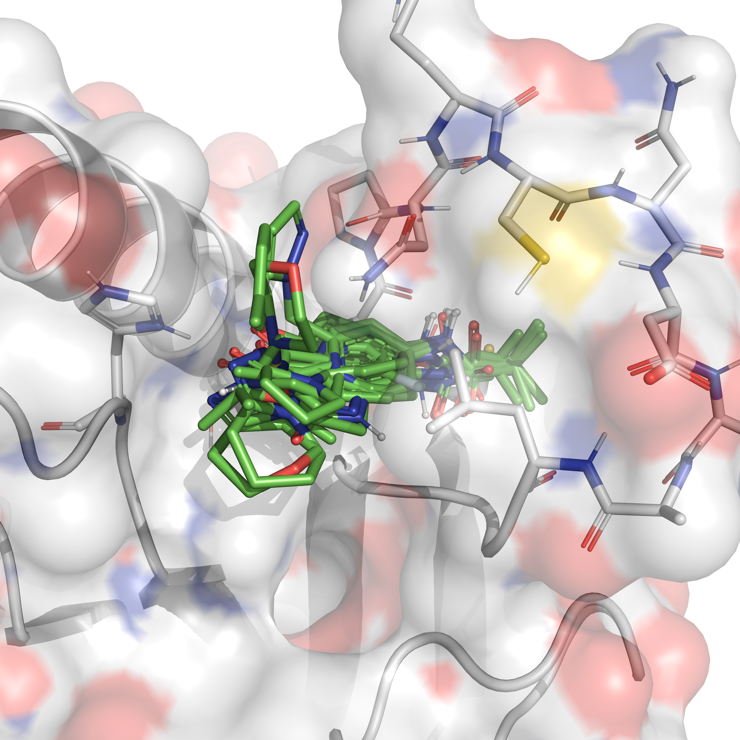
DOCK 3.8 Virtual screening workflow
a
Develop
docking model
b
b
c
d
Screen library
Iterate
Select hits
Desolvation
Van der Waals
Electrostactics
e
f
Make-on-demand
synthesis
Ultra large make-on-demand
chemical libraries
Experimental
testing
Building blocks
Lead-like products
Selected hits

Slide 30
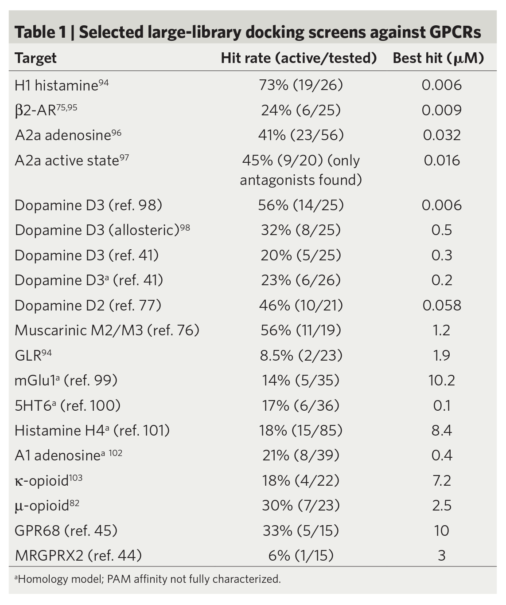
Why DOCK for virtual screening?
Optimized for efficiency
FORTRAN easier to optimize than C/C++/Python
Pre-compute
Rigid receptor energy grids
Ligand conformations / energetics
Fast hierarchical sampling
=> 1 second per compound
Physics based force-field
Tune for specific systems
Prospectively test in discovery campaigns
Culture of hit-picking parties
Minimize false discovery
Screen bigger libraries
*Can’t answer “how does this ligand bind”
(Roth, et al., 2017)

Slide 31
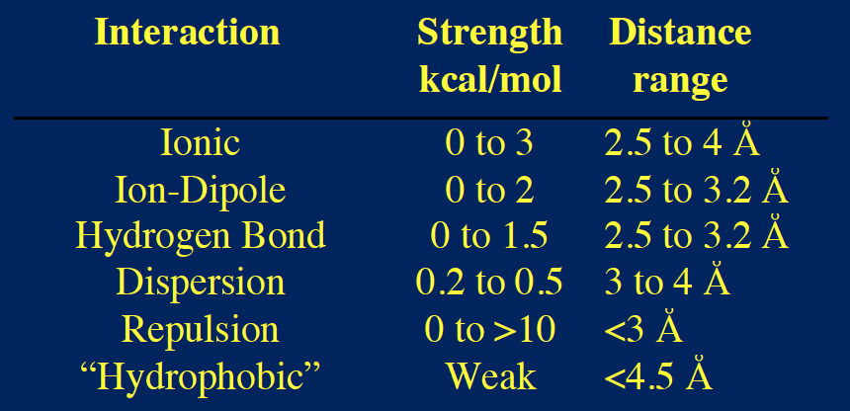
Summary of Molecular Interactions
Van der Waals
Electrostatics
Ligand desolvation

Slide 32
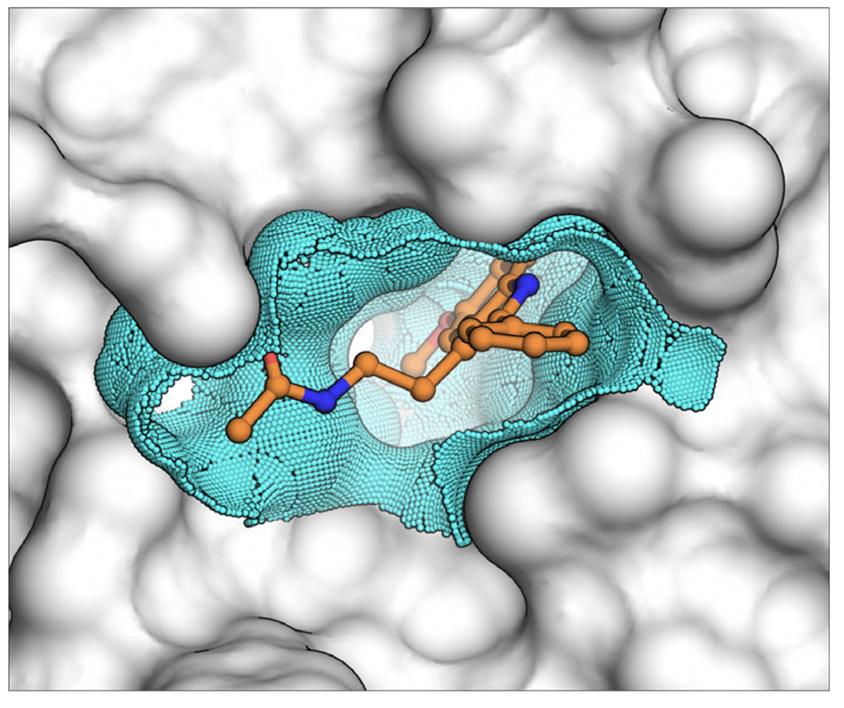
Dielectric spheres

Slide 33
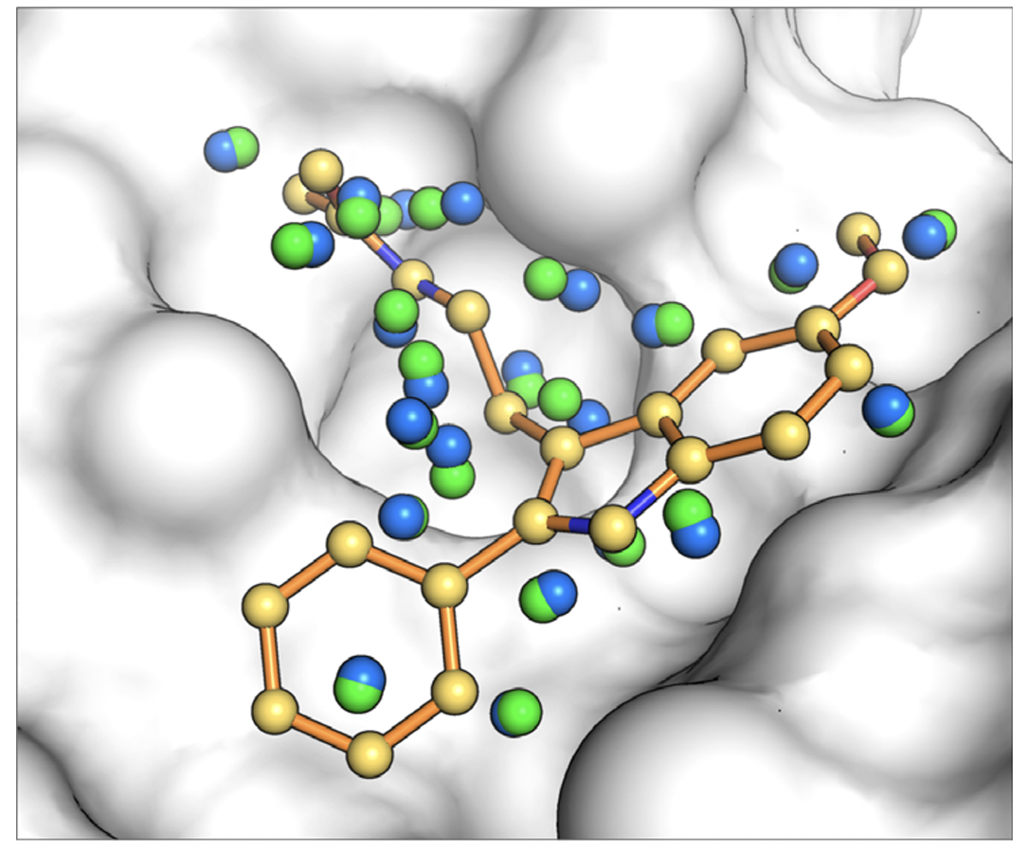
Matching Spheres
Xtal-lig spheres (gold)
Place spheres at atomic coordinates of reference ligand
SphGen (blue, green)
Flood binding site with spheres
Randomly perturb to test for robustness
Match, Anchor, and grow

Slide 34
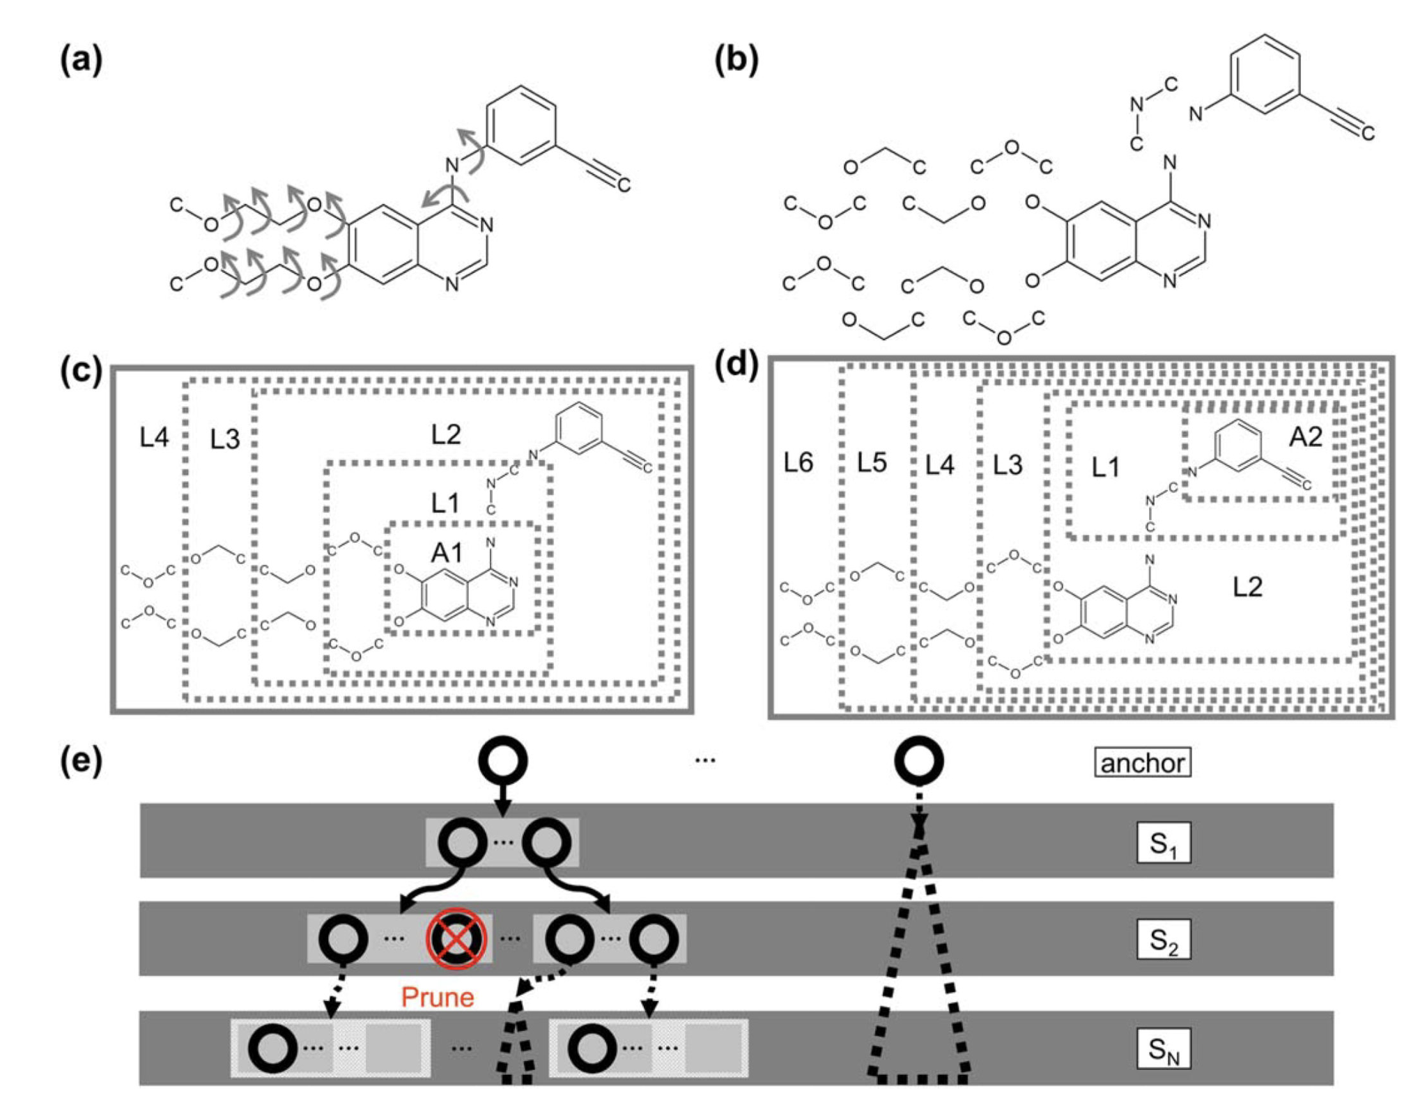
Anchor and grow sampling

Slide 35
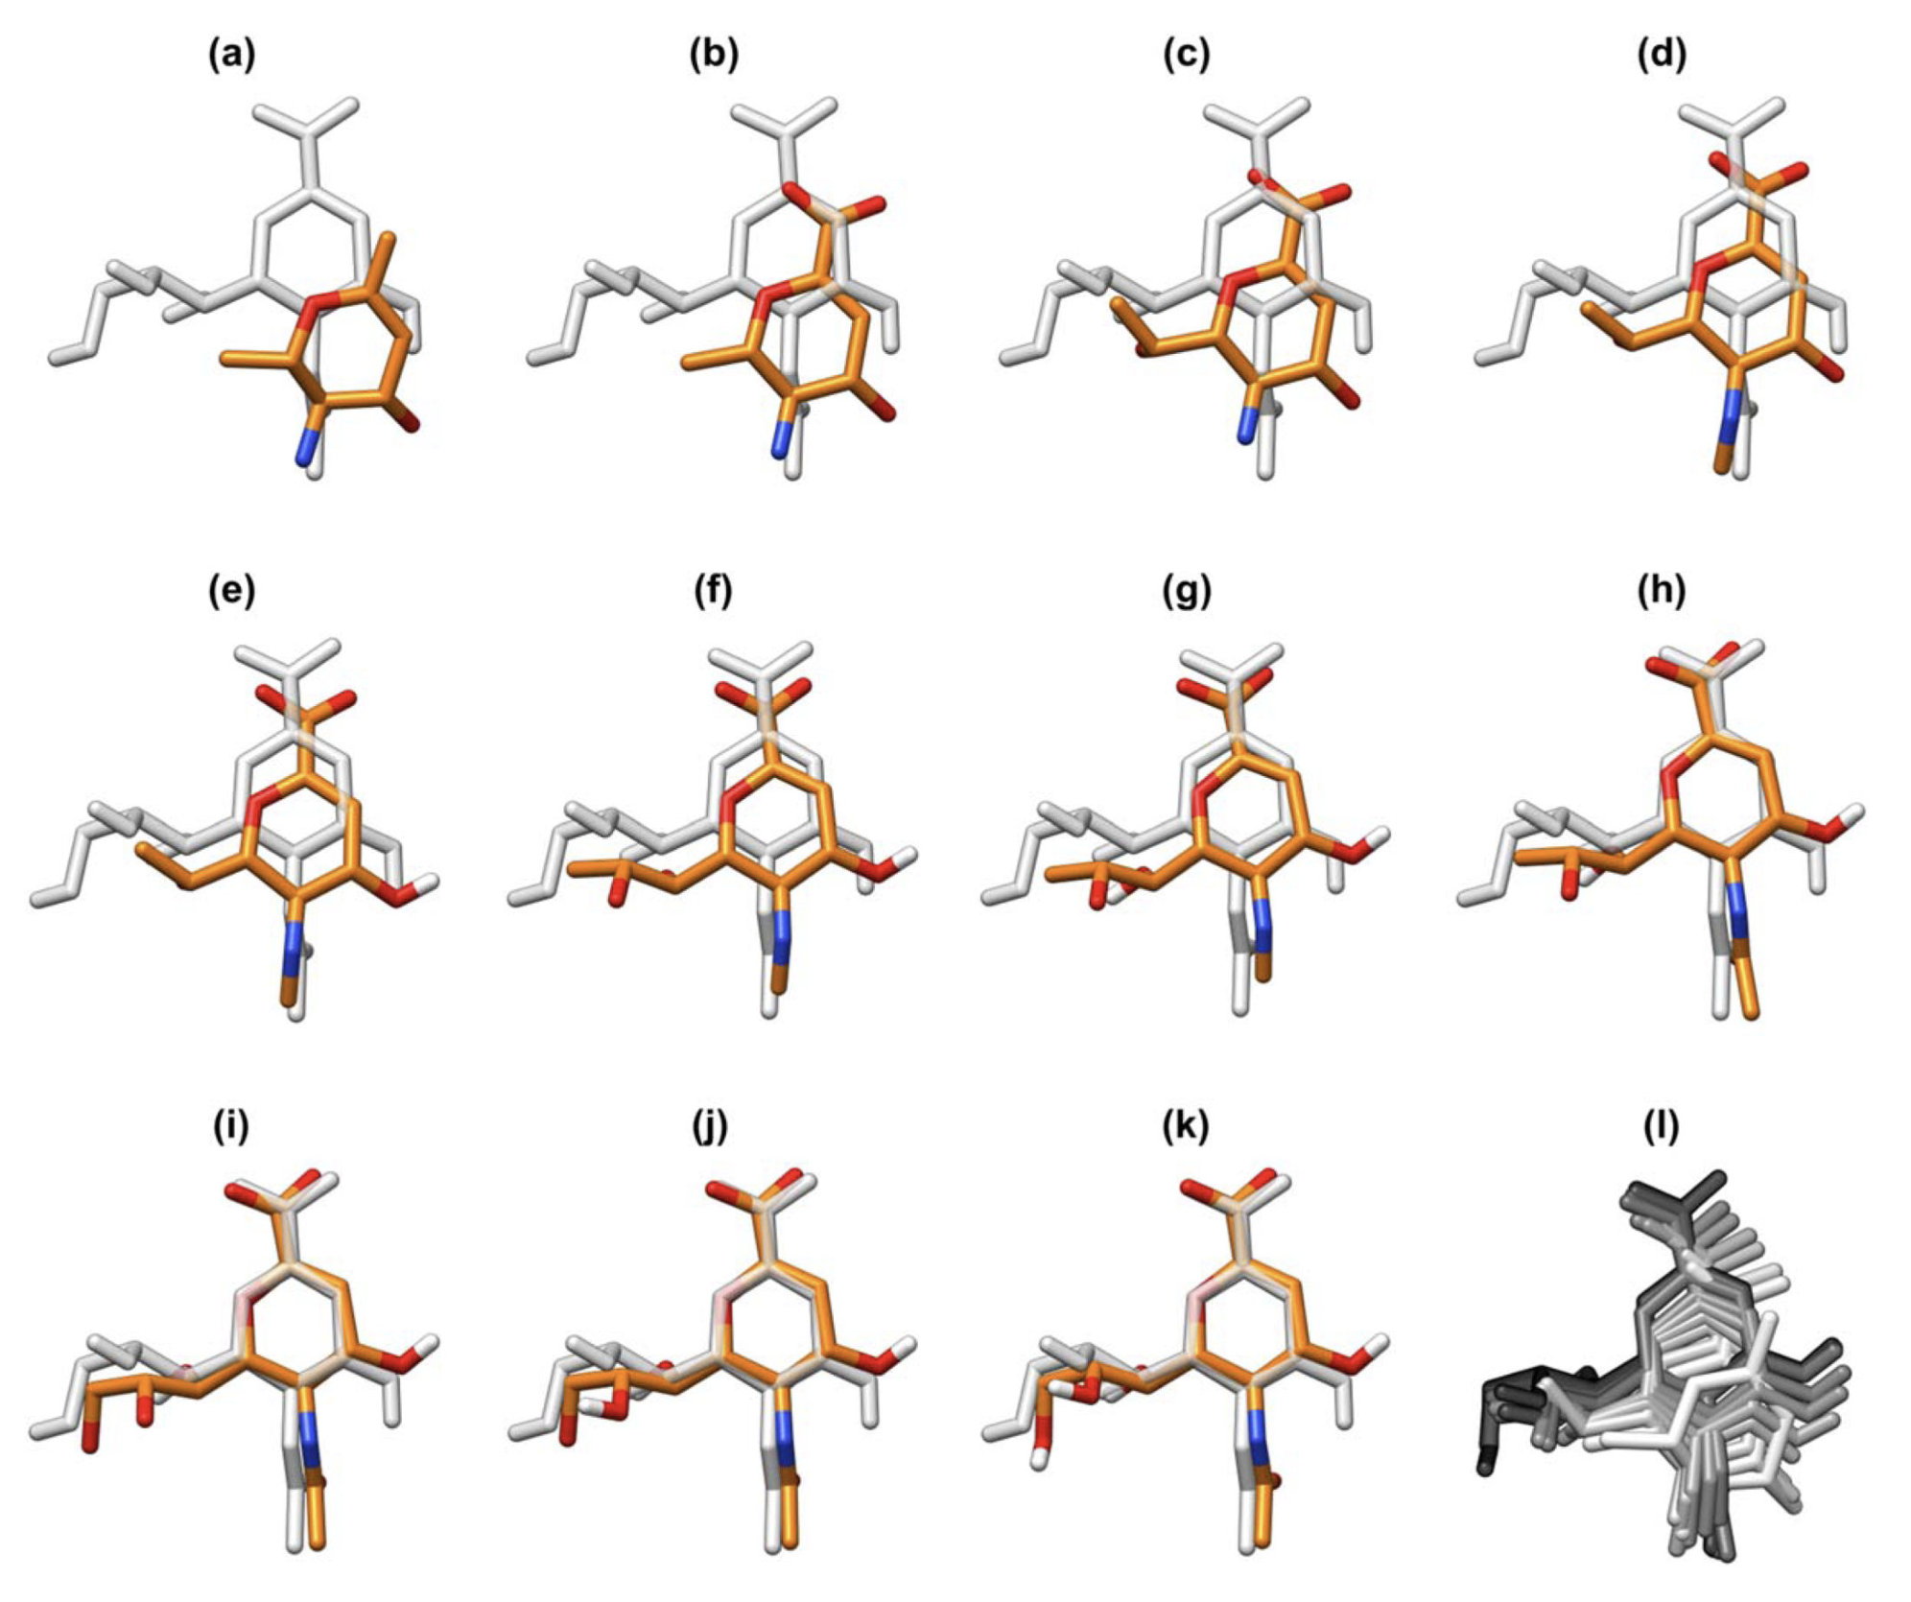
Anchor and grow sampling

Slide 36
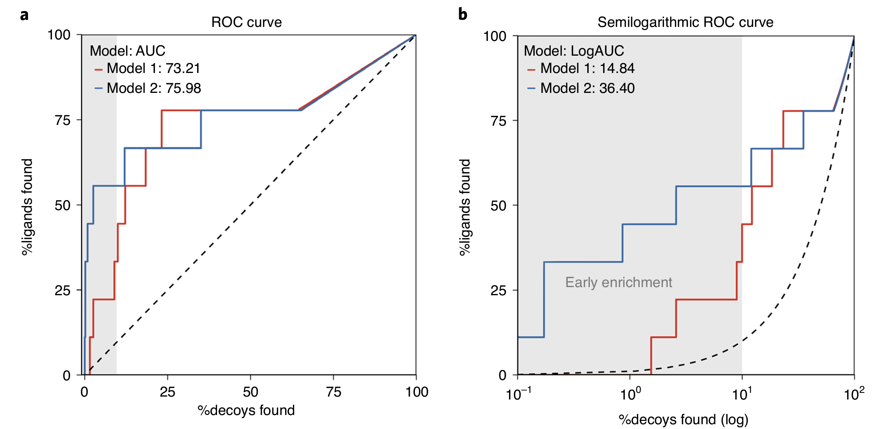
Log ROC as a measure of enrichment

Slide 37
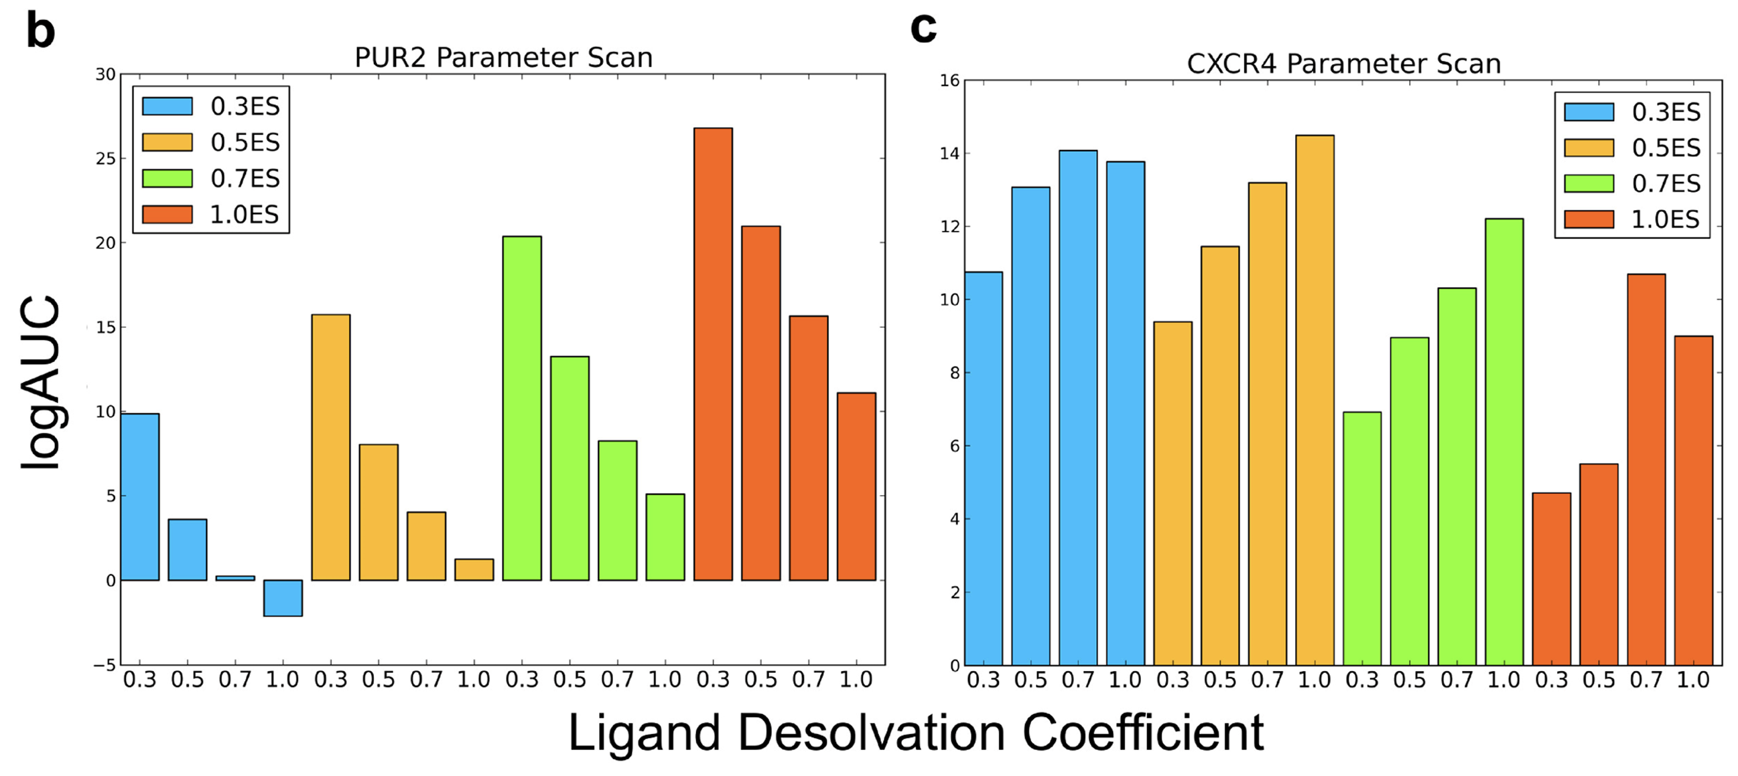
Decoy Discrimination of DUDE-E
Parameter scan:
Electrostatic energy: [0.3 – 1.0]
Ligand desolvation energy: [0.3 – 1.0]
(Stein, …, O’Meara, et al., 2021)

Slide 38
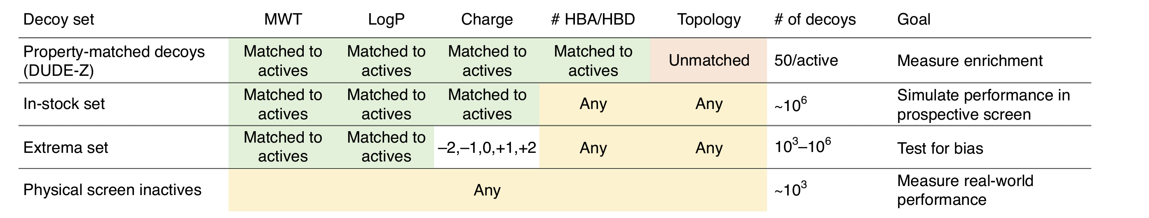
Retrospective Decoy sets

Slide 39
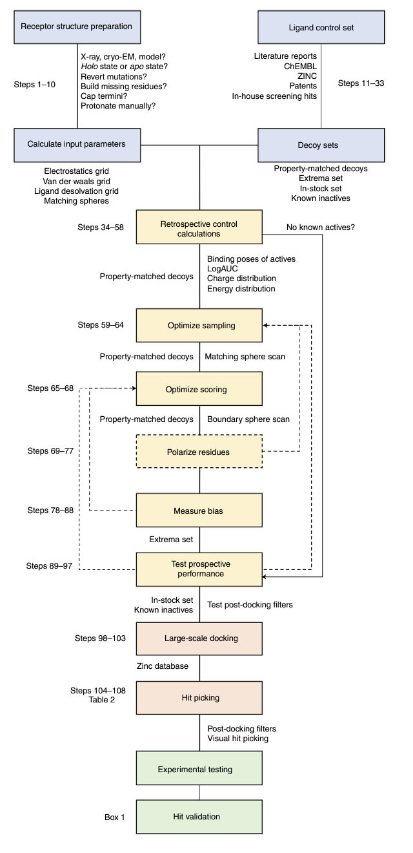
Docking workflow In Detail
(Bender, et al., 2021)

Slide 40
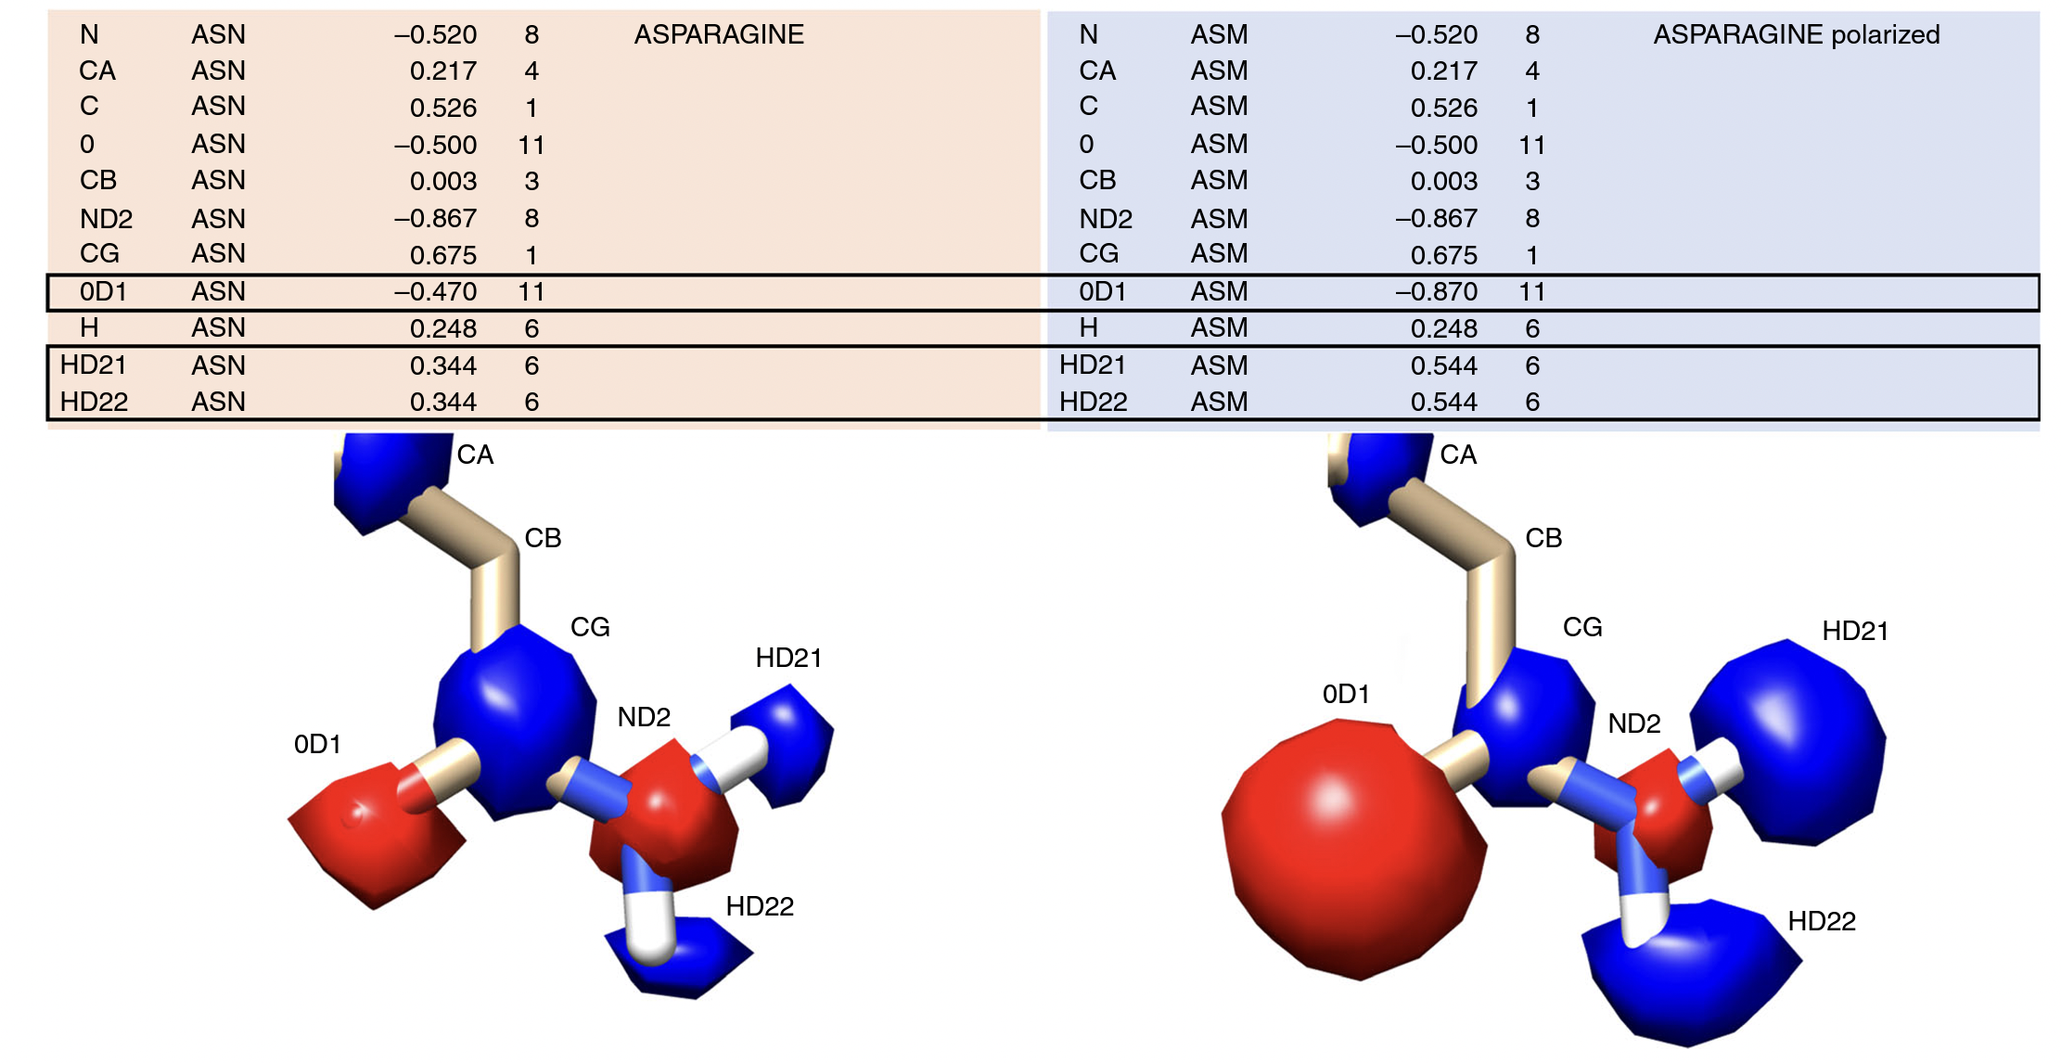
Adjusting partial charges of receptor atoms

Slide 41
Hit picking Criteria
Ligand strain
Does the geometry of the ligand look unfavorable
Receptor flexibility
Is the receptor have entropy before ligand binding?
Bound water, cofactors, protonation states, partial charges
Does the chemical state of the binding site need to be specified
Ligand med chem alerts
Does the ligand have toxic, reactive, promiscuous, or difficult to synthesis moieties?
Chemically similarity to known ligands?
Ligand-receptor engagement
Number of high-quality interactions
Fill the binding site
No wasted ligand atoms
Diversity of chemotypes/interactions
Multi-target docking scores
Selectivity for target / weighted average for multiple receptor states

Slide 42
Hit picking party format
Dock large-scale library
Do best first clustering for diversity
Look through ~5-10k by hand
Can automate through heuristic filtering
Interaction fingerprints
Calculate ligand strain energy
Train a ML classifier
Select 100-200 picked hits
Give everyone in lab / project team picked hits to score
Everyone scores compounds with letter grades
Use spreadsheet to aggregate scores and narrow down to ~50-100 top that need discussion
Come together and go through hits 1-2 hours
Everyone discusses why they like or dislike specific compounds
Opportunity to learn!
Request quote for 25-50 for synthesis
Receive 20-30 for testing

Slide 43
(Bender, et al., 2021)

Slide 44
(Bender, et al., 2021)

Slide 45
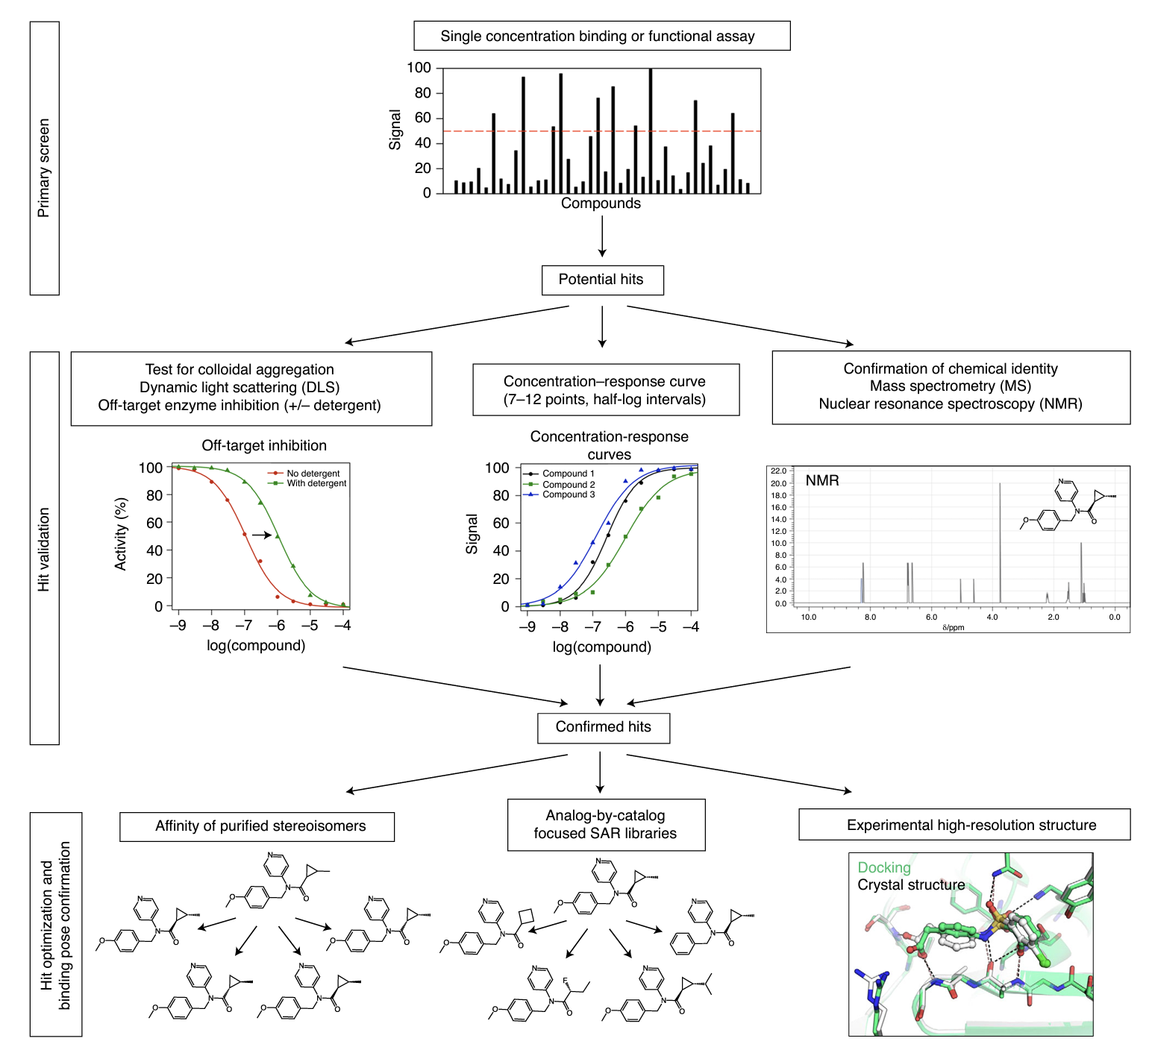
Experimental testing of virtual screening hits

